Slide 1
The Winning Entries of the MEMF School Competition 2022

Slide 2
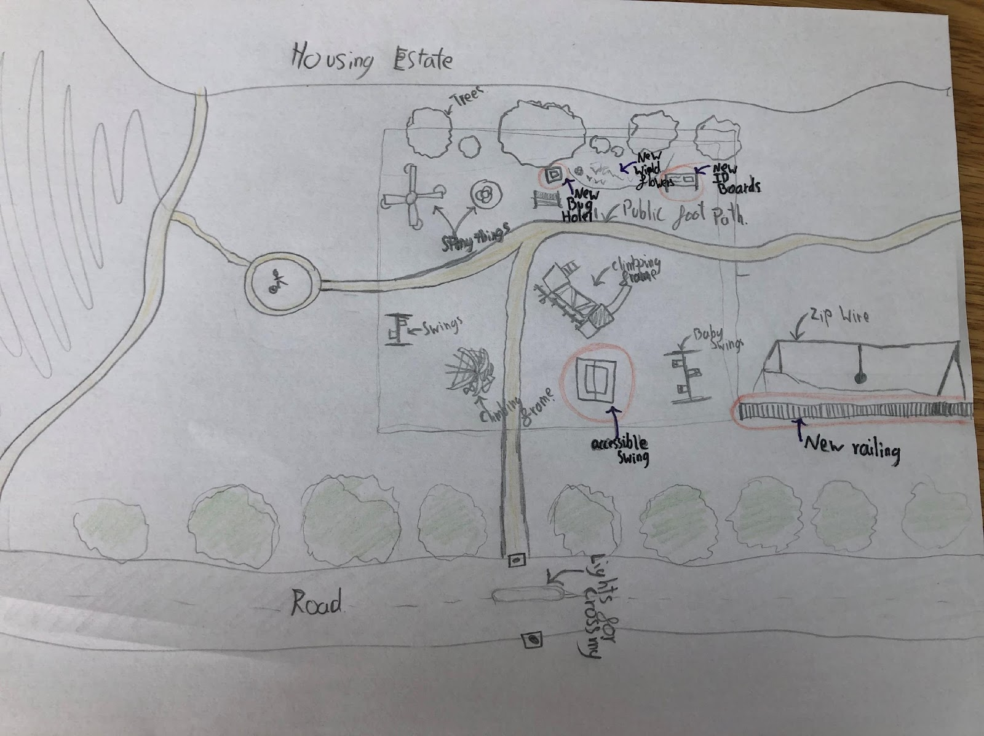
WINNING ENTRY: 11 TO 13 YEARS OLD
Inclusive play park from Felpham Community College
The judges were impressed with the thought and care taken into the designs of this project ensuring accessible equipment was integrated throughout the park so all children would be able to enjoy it together.
The submission assessed the current local park and identified areas that needed improving to ensure it was inclusive and accessible to all children.
The hand drawn designs brought the idea to life and how the park could practically be laid out.
VISIT MEMF.CAREERS

Slide 3
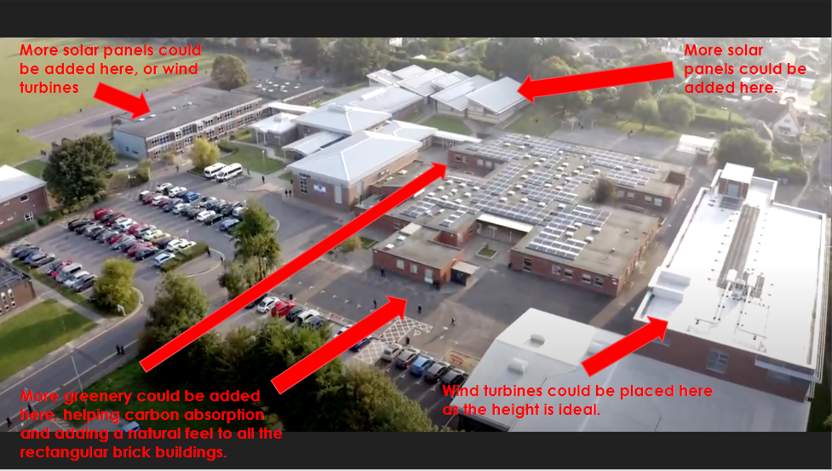
WINNING ENTRY: 14 TO 16 YEARS OLD
My Sustainable School from Felpham Community College
The submission provided practical and impactful suggestions on how their school facilities can be improved to become more sustainable. The submission explored using renewable energy sources, source local materials to build the extensions and the creation of more green space within the school grounds,
The project also touched on the impact having a more sustainable school will have on the staff and pupil and would create a better working environment.
The judges were impressed with the focus on sustainability and the practical actions that were laid out in the presentation.
VISIT MEMF.CAREERS

Slide 4
WINNING ENTRY: 17 TO 18 YEARS OLD
The Greater Reaches Community Centre from John Mason School
This entry assessed the local needs of the community and highlighted the importance of having a safe and inclusive space, which was showcased throughout the designs of the project.
Inspiration for the project was taken from the research they conducted on similar community regeneration projects across the UK. The designs of the building were also influence by local architecture and the needs of the local community.
The geographical location was also considered and how it would impact the designs and delivery of the project.
VISIT MEMF.CAREERS

Slide 5
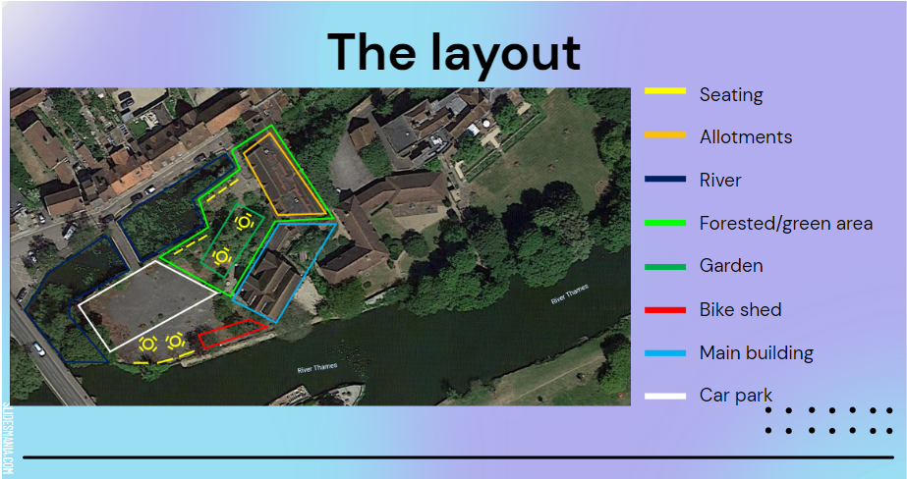
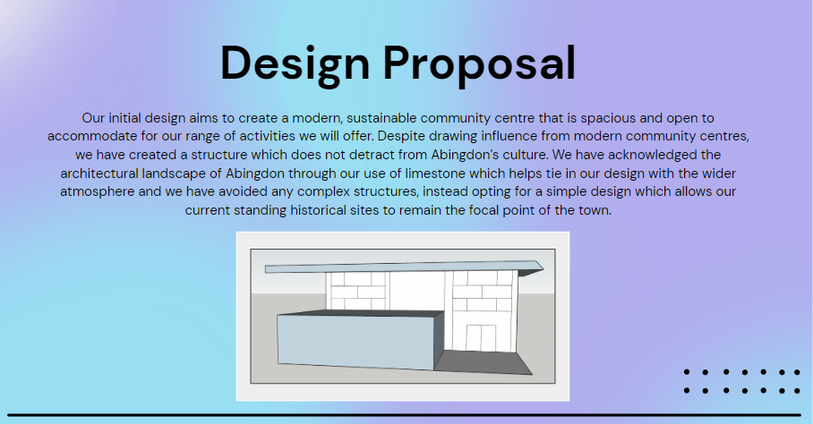
WINNING ENTRY: 17 TO 18 YEARS OLD
The Greater Reaches Community Centre from John Mason School (continued…)
The function of the community centre was to create a space for learning new skills (cooking , art, woodwork and transferable life skills), out activities (gardening, kayaking and sports) and specialised rooms for praying, hosting talks or performances. The presentation included a cost analyse to create the community centre .
The judges were impressed with consideration to sustainability and the needs and benefits to the local community.
VISIT MEMF.CAREERS

Slide 6
MEMF SUMMER SCHEME COMING SOON…
Student lead summer scheme
If you missed out on entering the school competition, don’t worry!
We have an exciting project launching in the upcoming weeks, where we have converted the school competition into a student led summer scheme.
To register your interest, please get in touch at info@cstt.org.uk
VISIT MEMF.CAREERS

